Slide 1
Lecture 14: Functions
CSC111: Introduction to CS through Programming
R. Jordan Crouser
Assistant Professor of Computer Science
Smith College

Slide 2
Announcements

Slide 3
Outline
Monday: FALL BREAK
Wednesday: Functions
basic components
definition vs. call
an analogy
parameters
returning values
LAB: MadLibs
Friday: Catching Exceptions

Slide 4
Functions
Recall: a function is a procedure / routine that takes in some input and does something with it (just like in math)
We’ve seen lots of built-in functions:
print(…)
input(…)
eval(…)
round(…)
Perhaps unsurprisingly, Python lets us write custom functions as well (like yesterday’s main() function)

Slide 5
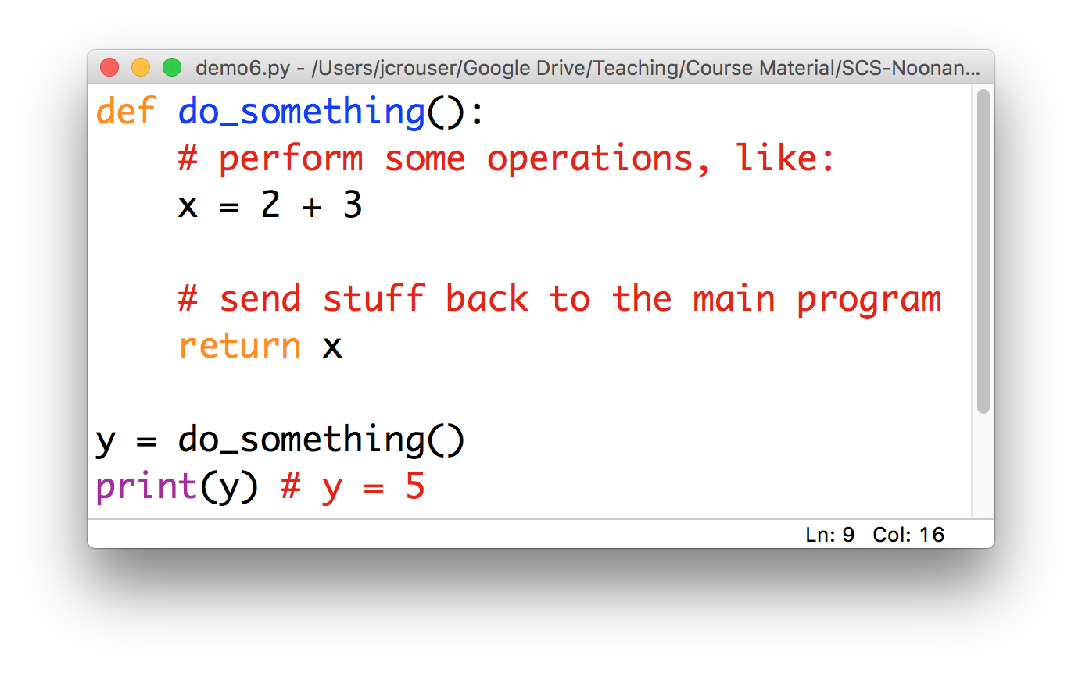
Basic components of a function

Slide 6
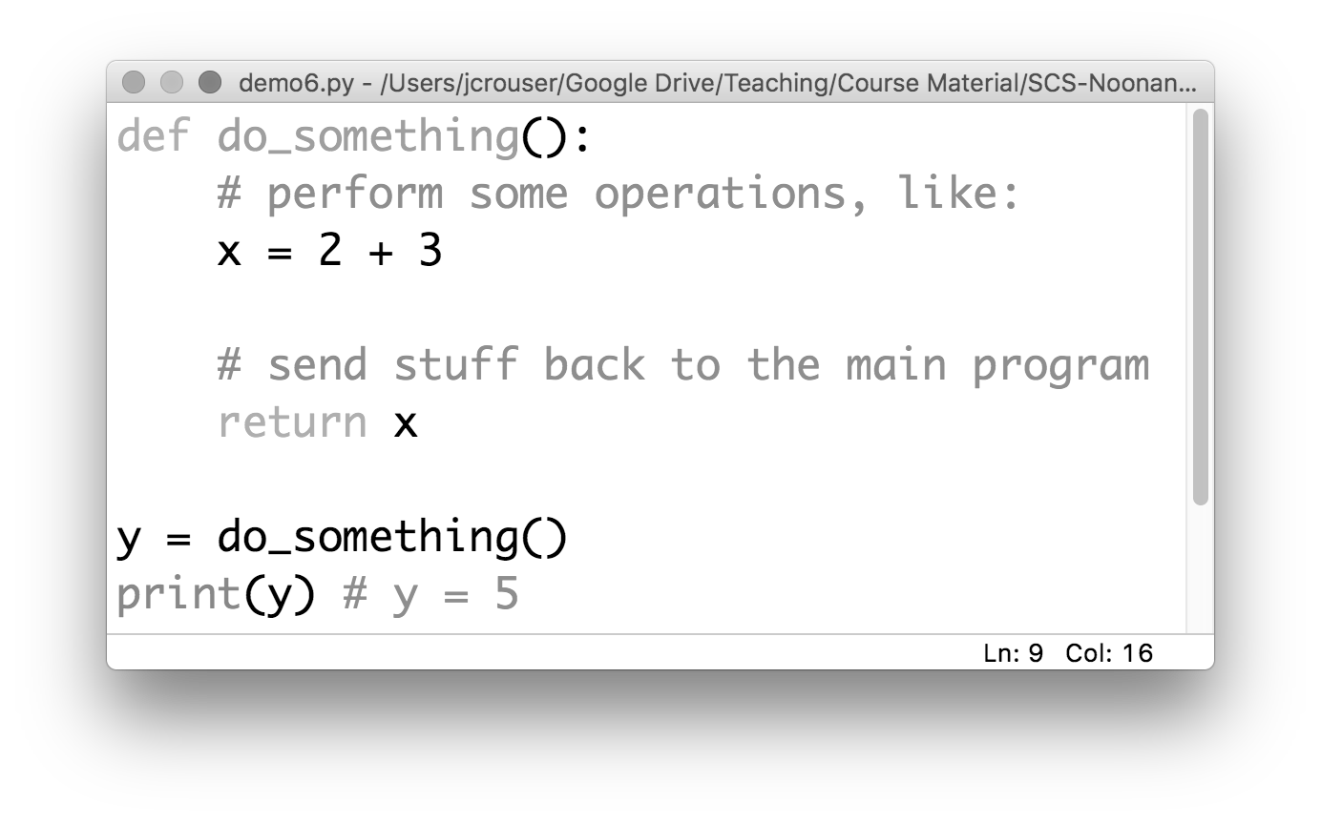
Basic components of a function
a name
Convention: use _underscores_ or camelCase

Slide 7
Basic components of a function
which is defined
using the def keyword

Slide 8
Basic components of a function
a body
(indented)

Slide 9
Basic components of a function
a return (optional)

Slide 10
A “function definition”

Slide 11

Discussion
What happens if we run this program?

Slide 12
A “function definition” is a description
(but not a directive)

Slide 13
Function calls: “hey, Python! do this”
a function call

Slide 14
Function calls: “hey, Python! do this”
5

Slide 15
An analogy
functions are your MINIONS

Slide 16
An analogy
functions have NAMES

Slide 17
An analogy
they only work when you CALL them

Slide 18
An analogy
main()
functions
can be
called by
main()
stuart()

Slide 19
An analogy
main()
functions
can also be
called by
one another
stuart()
jerry()

Slide 20
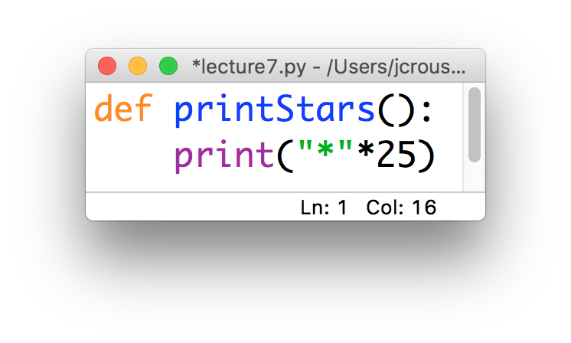
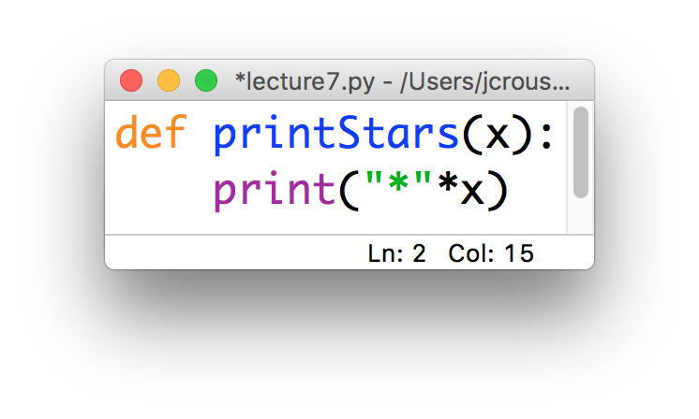
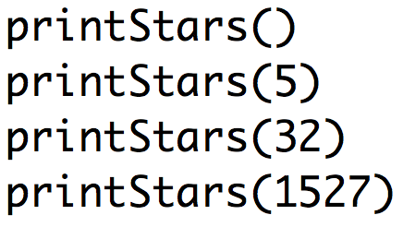
Two kinds of functions
Some functions always do the same thing
Others adjust their behavior based on what we give them
“parameter”

Slide 21
15-minute exercise: Happy Birthday
Write a function called happyBirthday(name) that takes in a string name and prints out the lyrics to the song ”Happy Birthday” with the name inserted:
Happy birthday to you!
Happy birthday to you!
Happy birthday, dear NAME
Happy birthday to you!
Call this function from inside the main() function, and use input(…) to get the value of name from the user

Slide 22
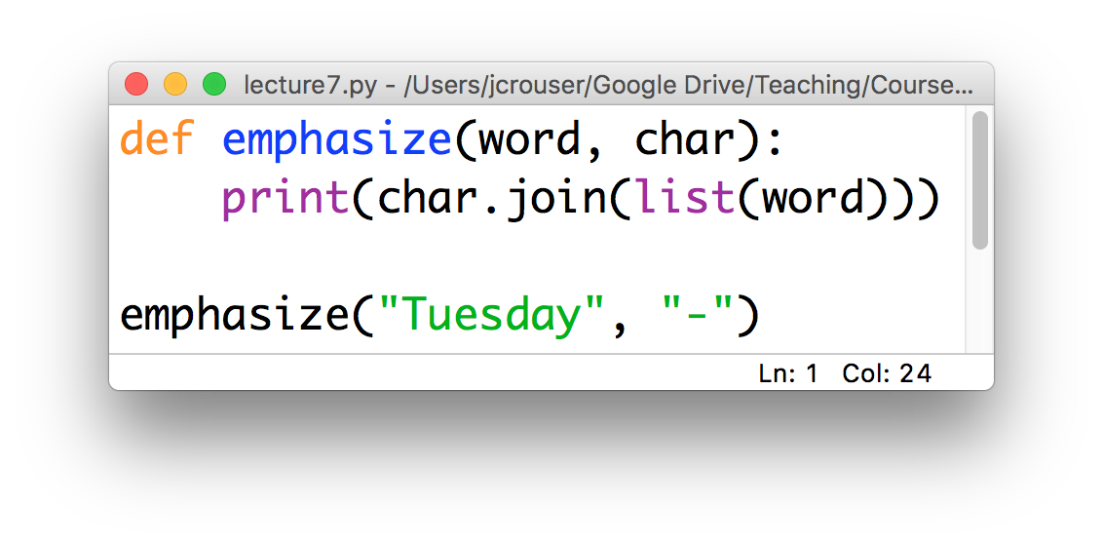
Parameters
Functions can be defined to take in multiple parameters:
Result:
T-u-e-s-d-a-y
char = “-”
word = “Tuesday”

Slide 23
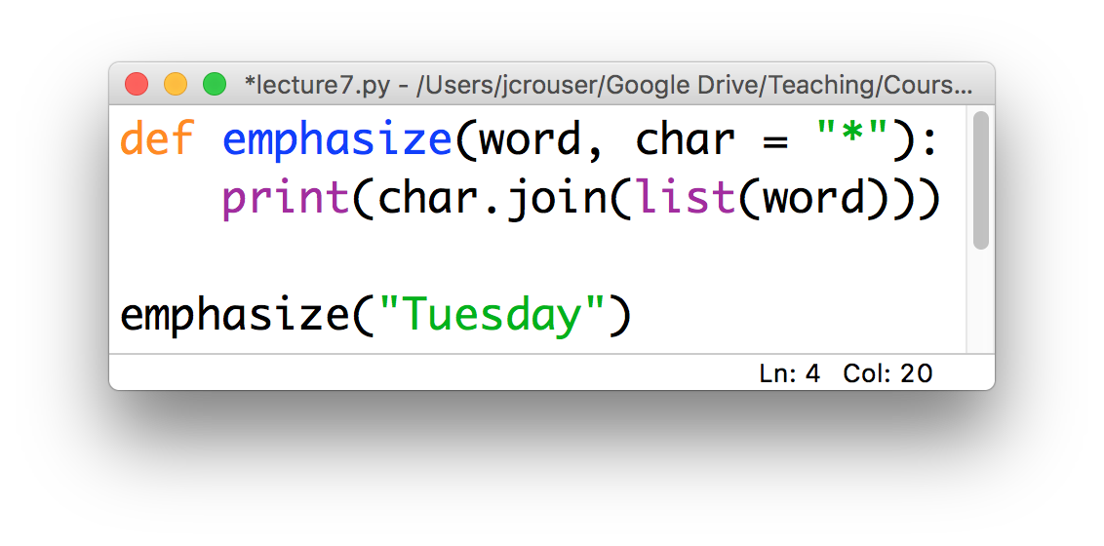
Default parameters
We can include a “default” value for some (or all) of them:
Result:
T*u*e*s*d*a*y
only one parameter

Slide 24
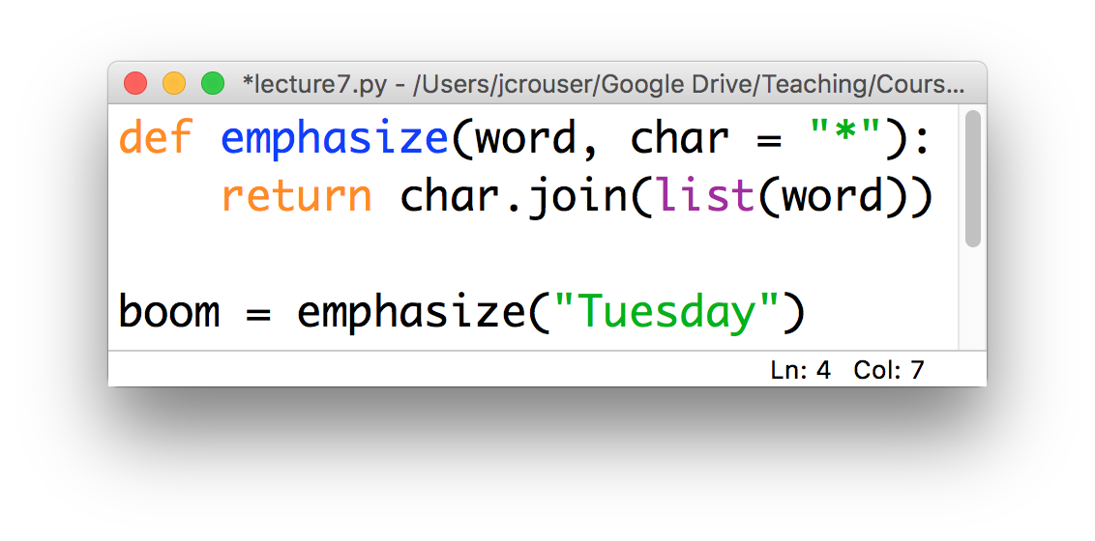
Returning values
We may want to return the results rather than print them:
the results of the return in
emphasize() are stored in boom

Slide 25
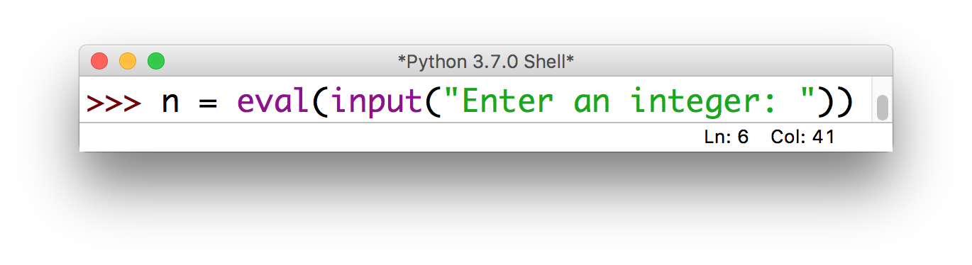
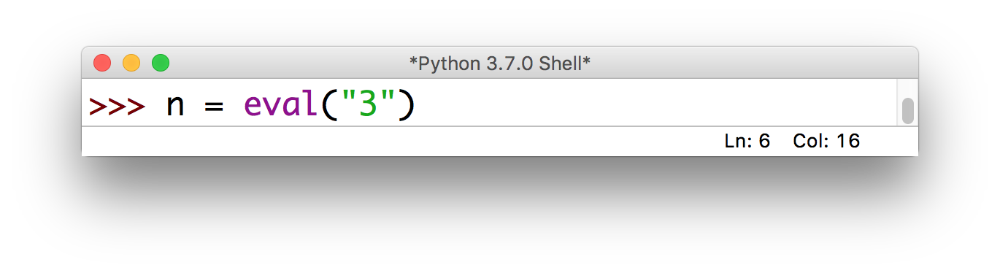
Advanced: chaining functions
Return values allow us to call functions inside other function calls:

Slide 26
Recap: functions
If you have to do something multiple times, then you probably want a function: this helps to “modularize” code (i.e. organize it for easy reuse)
Define once, call as many times as necessary
Naming convention: use camelCase
Important: one function = one task

Slide 27
(mini) Assignment 5: encrypt/decrypt
For this assignment, you’ll write 3 functions:
encrypt(…) will take in a string containing a message, and encrypt it using a variation of the PIG LATIN cipher*
decrypt(…) will undo the effects of encrypt(…), enabling us to recover the original message
main(…) will ask the user to enter a message, then call encrypt(…) and print the results, and finally call decrypt(…) on the encrypted message and print the decrypted original message
* for specific details, see assignment on Moodle

Slide 28
Outline
Monday: FALL BREAK
Wednesday: Functions
basic components
definition vs. call
an analogy
parameters
returning values
LAB: MadLibs
Friday: Catching Exceptions

Slide 29
It was a(n) ____________ October day. I awoke to the
adjective
smell of ____________ roasting in the ____________.
type of food room in house
I ____________ down the stairs and much to my
verb (past tense, -ed)
____________, I ran directly into a(n) ____________
emotion adjective
____________. I found this very strange, because…
noun

